Slide 1
Establishing collaborative relationships with
local referral agencies to increase WIC clientele
in Clackamas County, Oregon
Andrea Cox, Jaime Ruisi, Sarah Larimer

Slide 2
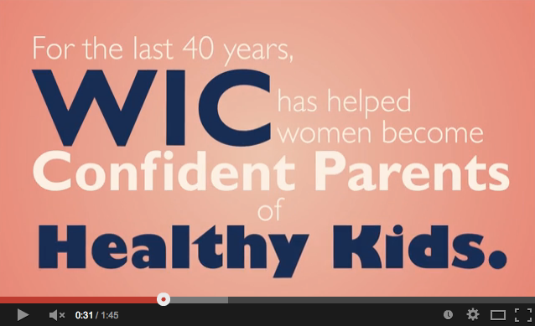
WIC Overview
http://youtu.be/ghPyQAwNHi0

Slide 3
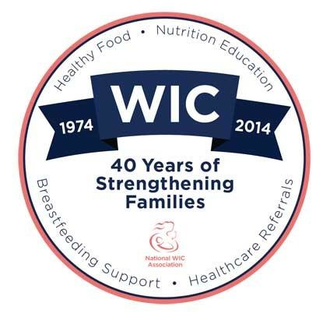
WIC
The Supplemental Nutrition Program for Women, Infants, and Children
Aims to help low-income pregnant, postpartum and breastfeeding women as well as children up to the age of five by making nutritious foods available
Provides nutrition education, breastfeeding
services, and healthcare referrals

Slide 4
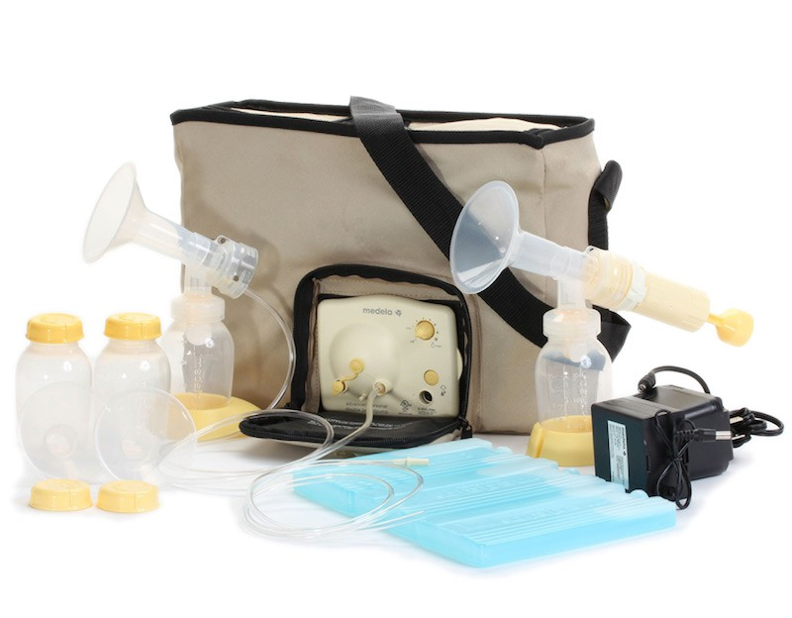
Services Provided
Nutrition education through counseling, classes
and educational resources
Referrals to health and human
services
Breastfeeding education and
support

Slide 5
Foods provided
Fruits & Vegetables
Food packages are specialized for pregnant, breastfeeding and postpartum women
Packages are different for infants and children
All packages are designed to deliver essential nutrients to WIC clients
Peanut Butter
Legumes
Dairy
Juice
Eggs
Grains

Slide 6
The Problem…
Not all women are taking advantage of WIC services!
WIC agencies across the nation are experiencing
low enrollment rates
Why?
Lack of knowledge
Low health literacy
Low collaboration with other government programs (i.e. Head Start) due to location and staff workloads
Gilbert D, Nanda J, Paige D. Securing the safety net: Concurrent participation in income eligible assistance programs. Matern Child Health J. 2014;18:604-612.

Slide 8
Our Goal
To increase enrollment of pregnant women in the Clackamas County Special Supplemental Nutrition Program for Women, Infants and Children (WIC) program by informing medical personnel at referral agencies about WIC’s services.

Slide 9
Objectives
By December 14th, 2015, we aim to increase the number of women on Medicaid in Clackamas County who are also enrolled in WIC from 15-20% to 25-30% compared to December 2013.
By December 14th, 2015, we plan to increase the total number of WIC eligible women who receive WIC services by 7% in Clackamas County compared to December 2013.
By March 1st 2015, we plan to increase the number of WIC referrals from medical agencies within Clackamas County by 20% compared to December 2013.

Slide 10
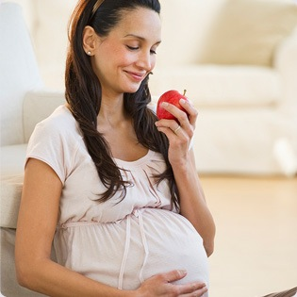
Significance
By administering food and nutrition services, WIC has decreased the risk of poor birth outcomes and improved the health of participants during a critical time of development
Pregnant women enrolled in WIC receive earlier prenatal care, experience more full-term pregnancies, have fewer low birth weight babies and fewer fetal and infant deaths
Khanani I, Elam J, Hearn R, et al. The impact of prenatal WIC participation on infant mortality and racial disparities. Am J Public Health. 2010;100(Supp1):S204–S209. <http://www-ncbi-nlm-nih-gov.liboff.ohsu.edu/pmc/articles/PMC2837444/>.

Slide 11
Significance
In 2011, only 70% of women on Medicaid nationally utilized WIC services
Rates of pregnant women enrolled on WIC in Clackamas County are among the lowest in the state
In 2013, 31% of eligible pregnant women utilized WIC in Clackamas County, 45% of women utilized WIC in Oregon overall
Increased participation in WIC services would ultimately lead to better birth outcomes and healthier moms in Clackamas County, Oregon
El-Bastawissi AY, Peters R, Sasseen K, Bell T, Manolopoulus R. Effect of the Washington Special Supplemental Nutrition Program for Women; Infants and Children. Matern Child Health J. 2007; http://link.springer.com.liboff.ohsu.edu/article/10.1007/s10995-007-0212-5/fulltext.html

Slide 12
Target Audience
Health Providers in Clackamas County, Oregon
WIC provided
Pregnancy resources
Women, children and infants that qualify for the WIC program in Clackamas County, Oregon
Residential
Income
Nutrition Risk
Notes:
Planned Parenthood located in SE Portland
Pregnancy Resource Centers located in Gresham, Clackamas, Sandy, Estacada, Lake Oswego and SE Portland
Pregnancy Care Centers in Molalla and Canby
Medical Providers in Clackamas County - 117 total, list provided by Clackamas County WIC
Women who are pregnant, postpartum, or breastfeeding
Infants up to their first birthday
Children up to their fifth birthday
Income- cannot exceed more than 185% of the federal poverty income guidlines

Slide 13
Methodology
WIC educates referring agencies
Referring agencies increase number of referrals to WIC
More clients sign up for WIC benefits

Slide 14
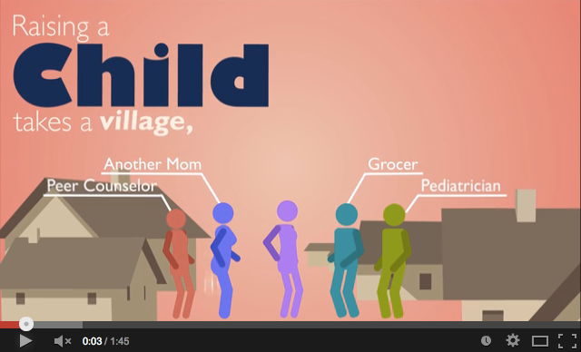
Educational Materials
WIC 40th Birthday Card- Coming Soon!

Slide 15
Time Table
 | Completion Date
Order materials | December 1st, 2014
Package materials | January 10th, 2015
Distribute materials in person | January 21st-24th, 2015
Mail materials to all agencies not visited | January 31st, 2015
Evaluate January WIC clientele numbers | January 31st, 2015
Evaluate February WIC clientele numbers | February 28th, 2015
Evaluate March WIC clientele numbers | March 31st, 2015
Evaluate total WIC statistics (done by WIC) | December 14th, 2015

Slide 16
Evaluation
Every month, WIC documents :
Total number of participants
How new participants heard about WIC
In December of 2015, the Clackamas County WIC will reevaluate the number of WIC eligible women on Medicaid in the Clackamas County area.

Slide 17
Budget
Item: | Cost: | Notes:
Labor | Free | Dietetic Intern Project
Paper, white 8 ½” x 11” | $16.00 | Paper will be used for the cover letter, and WIC brochure (500 sheets=$7.99)*
Postage | aprox. $125.00 | Postage will depend greatly on referral list of 126 at approximately $0.98/letter
DVD | $50.00 | DVDs will be used to send the video to all interested agencies. (100 disks=$50.00)*
Total Cost: | $191.00

Slide 18
Thank you Clackamas County WIC and our mentor Julie Aalbers!

